Slide 1
Distributed System
(BESE-VII)
Compiled by
Er. Madan Kadariya
Assistant Professor
HOD, Department of Information Technology Engineering
Nepal College of Information Technology
Balkumari, Lalitpur

Slide 2
Chapter 1: Introduction to Distributed System
  References:
  G. Coulouris, J. Dollimore and T. Kindberg; Distributed Systems Concepts and Design,4th Edition.
  Andrew S. Tanenbaum and Maarten van Steen; Distributed Systems: Principles and Paradigms, 2nd Edition.
Distributed System (DS)

Slide 3
Topics
SYSTEM MODEL
1.3. Models of Distributed System 1.3.1. Architectural 1.3.2. Fundamental 1.3.3. Failure Model Introduction Architectural Models Fundamental Models Failure Models
Distributed System (DS)

Slide 4
Introduction
SYSTEM MODEL
An architectural model of a distributed system is concerned with the placement of its parts and the relationships between them. Define the main components of the system, what their roles are and how they interact (software architecture), and how they are deployed in a underlying network of computers (system architecture); Examples include: Client-Server model Peer-to-Peer model
Distributed System (DS)
Notes:
CP8304- Ryerson University

Slide 5
Introduction
SYSTEM MODEL
Variations of client-sever model can be formed by: The partition of data or replication at cooperative servers The caching of data by proxy servers and clients The use of mobile code and mobile agents The requirement to add or remove mobile devices in a convenient manner Fundamental Models deal with a more formal description of the properties that are common in all of the architectural models. Some of these properties in distributed systems are: There is no global time in a distributed system. All communication between processes is achieved by means of messages.
Distributed System (DS)
Notes:
CP8304- Ryerson University

Slide 6
Introduction
SYSTEM MODEL
Message communication in distributed systems has the following properties: Delay Failure Security attacks
Distributed System (DS)
Notes:
CP8304- Ryerson University

Slide 7
Introduction
SYSTEM MODEL
Message communication issues are addressed by three models: Interaction Model It deals with performance and with the difficulty of setting of time limits in a distributed system. For example for message delivery. Failure Model It attempts to give a precise specification of the faults that can be exhibited by processes and communication channels. It defines reliable communication and correct processes.
Security Model It discusses possible threats to processes and communication channels.
Distributed System (DS)
Notes:
CP8304- Ryerson University

Slide 8
Architectural Models-Intro
SYSTEM MODEL
The architecture of a system is its structure in terms of separately specified components. The overall goal is to ensure that the structure will meet present and likely future demands on it. Major concerns are to make the system: Reliable Manageable Adaptable Cost-effective
Distributed System (DS)
Notes:
CP8304- Ryerson University

Slide 9
Architectural Models-Intro
SYSTEM MODEL
An architectural Model of a distributed system first simplifies and abstracts the functions of the individual components of a distributed system. An initial simplification is achieved by classifying processes as: Server processes Client processes Peer processes Cooperate and communicate in a symmetric manner to perform a task.
Distributed System (DS)
Notes:
CP8304- Ryerson University

Slide 10
Software Layers
SYSTEM MODEL
Software architecture referred to: The structure of software as layers or modules in a single computer. The services offered and requested between processes located in the same or different computers. Software architecture is breaking up the complexity of systems by designing them through layers and services. Layer: a group of related functional components. Service: functionality provided to the next layer. (Figure 1)
Distributed System (DS)
Notes:
CP8304- Ryerson University

Slide 11
Software Layers
SYSTEM MODEL
Layer N
…
Layer 2
(services offered to above layer)
Layer 1
Figure 1. Software layers
Distributed System (DS)
Notes:
CP8304- Ryerson University

Slide 12
Software Layers
SYSTEM MODEL
Platform The lowest-level hardware and software layers are often referred to as a platform for distributed systems and applications. These low-level layers provide services to the layers above them, which are implemented independently in each computer. These low-level layers bring the system’s programming interface up to a level that facilitates communication and coordination between processes. (Figure 2)
Distributed System (DS)
Notes:
CP8304- Ryerson University

Slide 13
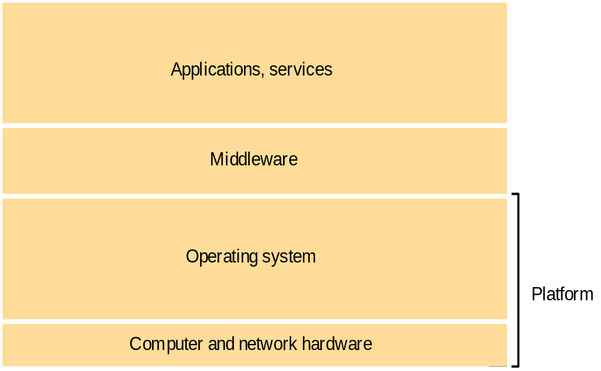
Software Layers
SYSTEM MODEL
Figure 2. Software and hardware service layers in distributed systems
Distributed System (DS)
Notes:
CP8304- Ryerson University

Slide 14
Software Layers
SYSTEM MODEL
Middleware A layer of software whose purpose is to mask heterogeneity presented in distributed systems. To provide a convenient programming model to application developers. Major Examples of middleware are: Sun RPC (Remote Procedure Calls) OMG CORBA (Common Object Request Broker Architecture) Microsoft D-COM (Distributed Component Object Model) Sun Java RMI
Distributed System (DS)
Notes:
CP8304- Ryerson University

Slide 15
System Architectures
SYSTEM MODEL
The most evident aspect of distributed system design is the division of responsibilities between system components (applications, servers, and other processes) and the placement of the components on computers in the network. It has major implication for: Performance Reliability Security Client-Server model Most often architecture for distributed systems. Client process interact with individual server processes in a separate host computers in order to access the shared resources
Distributed System (DS)
Notes:
CP8304- Ryerson University

Slide 16
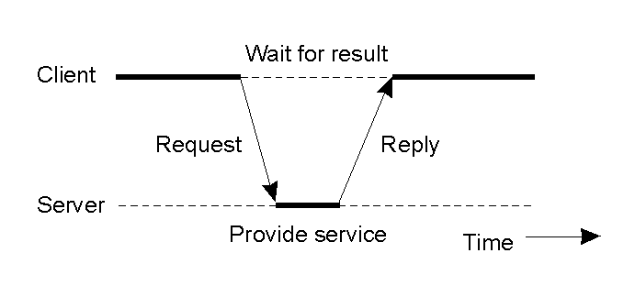
System Architectures
SYSTEM MODEL
Servers may in turn be clients of other servers. E.g. a web server is often a client of a local file server that manages the files in which the web pages are stored. E.g. a search engine can be both a server and a client: it responds to queries from browser clients and it runs web crawlers that act as clients of other web servers.
Distributed System (DS)
Notes:
CP8304- Ryerson University

Slide 17
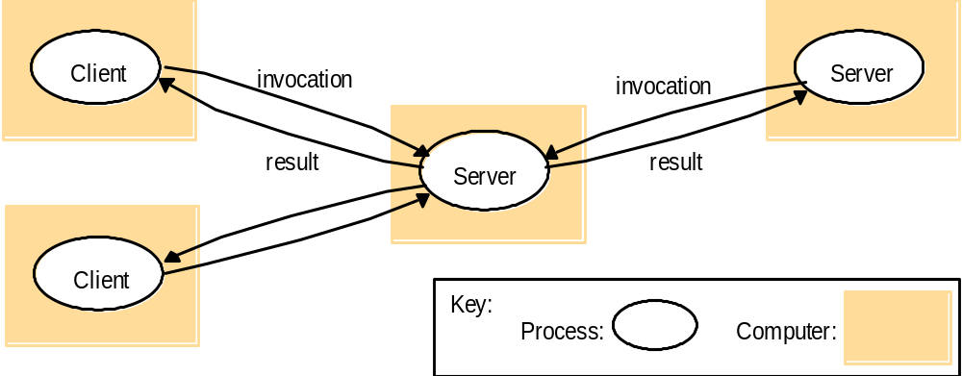
System Architectures
SYSTEM MODEL
Figure 4. Clients invoke individual servers
Distributed System (DS)
Notes:
CP8304- Ryerson University

Slide 18
System Architectures
SYSTEM MODEL
Peer-to-Peer model All of the processes play similar roles, interacting cooperatively as peers to perform a distributed activities or computations without any distinction between clients and servers or the computers that they run on. E.g., music sharing systems Napster (Figure 5)
Distributed System (DS)
Notes:
CP8304- Ryerson University

Slide 19
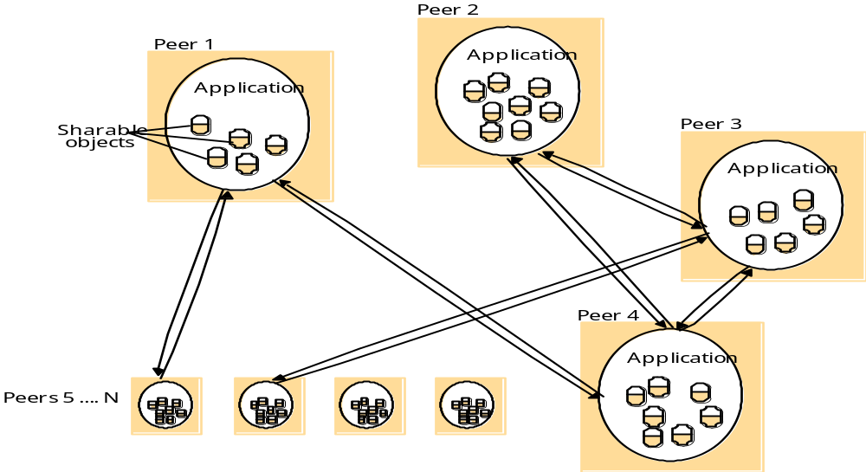
System Architectures
SYSTEM MODEL
Figure 5. A distributed application based on the peer-to-peer architecture
Distributed System (DS)
Notes:
CP8304- Ryerson University

Slide 20
Variants of Client Sever Model
SYSTEM MODEL
The problem of client-server model is placing a service in a server at a single address that does not scale well beyond the capacity of computer host and bandwidth of network connections. To address this problem, several variations of client-server model have been proposed. Some of these variations are discussed in the next slide.
Distributed System (DS)
Notes:
CP8304- Ryerson University

Slide 21
Variants of Client Sever Model
SYSTEM MODEL
Services provided by multiple servers Services may be implemented as several server processes in separate host computers interacting as necessary to provide a service to client processes. E.g. cluster that can be used for search engines. (Figure 6)
Distributed System (DS)
Notes:
CP8304- Ryerson University

Slide 22
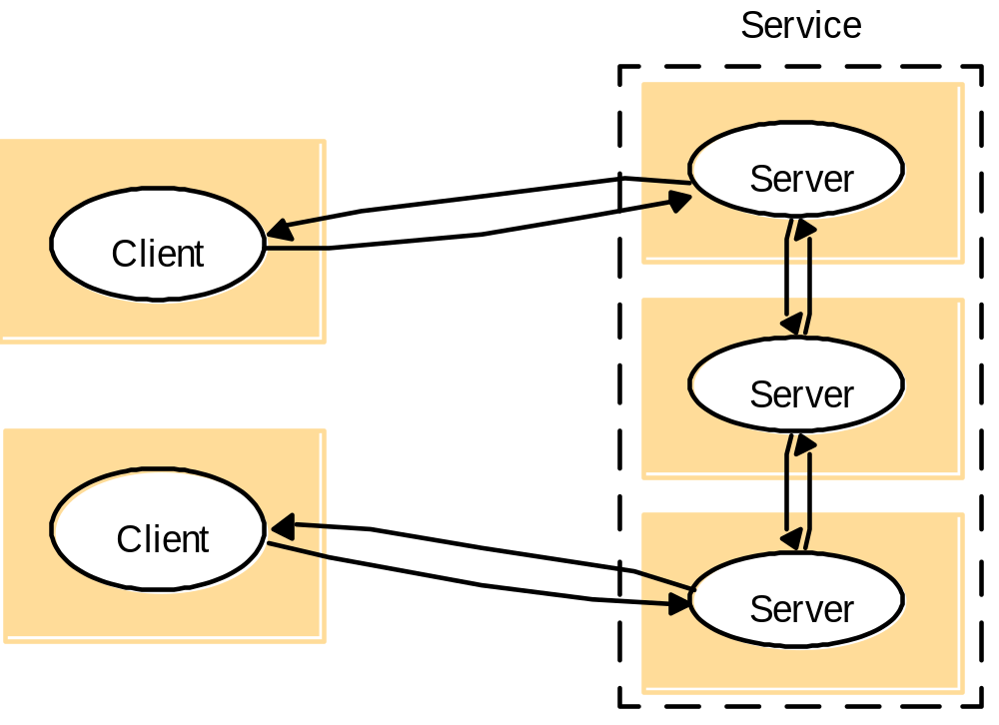
Variants of Client Sever Model
SYSTEM MODEL
Figure 6. A service provided by multiple servers.
Distributed System (DS)
Notes:
CP8304- Ryerson University

Slide 23
Variants of Client Sever Model
SYSTEM MODEL
Proxy servers and caches A cache is a store of recently used data objects. When a new object is received at a computer it is added to the cache store, replacing some existing objects if necessary. When an object is needed by a client process the caching service first checks the cache and supplies the object from there if an up-to-date copy is available. If not, an up-to-date copy is fetched.
Distributed System (DS)
Notes:
CP8304- Ryerson University

Slide 24
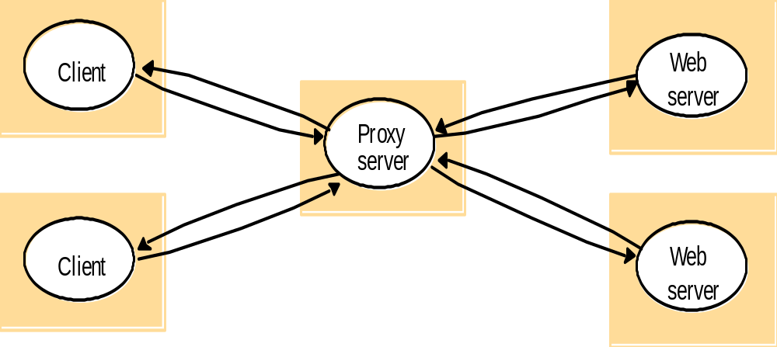
Variants of Client Sever Model
SYSTEM MODEL
Client/server model with proxy-server: Cache: stores recently-used data objects that are closer to the client than the original objects themselves. Caches may be collected with each client or they may be located in a proxy server that can be shared by several clients. Proxy server: cache that is shared between several clients
Distributed System (DS)
Figure 7. Web proxy server
Notes:
CP8304- Ryerson University

Slide 25
Variants of Client Sever Model
SYSTEM MODEL
Mobile code Applets are a well-known and widely used example of mobile code. Applets downloaded to clients give good interactive response Mobile codes such as Applets are a potential security threat to the local resources in the destination computer.
Distributed System (DS)
Notes:
CP8304- Ryerson University

Slide 26
Variants of Client Sever Model
SYSTEM MODEL
Browsers give applets limited access to local resources. For example, by providing no access to local user file system. E.g. a stockbroker might provide a customized service to notify customers of changes in the prices of shares; to use the service, each customer would have to download a special applet that receives updates from the broker’s server, display them to the user and perhaps performs automatic to buy and sell operations triggered by conditions set up by the customer and stored locally in the customer’s computer. (Figure 8)
Distributed System (DS)
Notes:
CP8304- Ryerson University

Slide 27
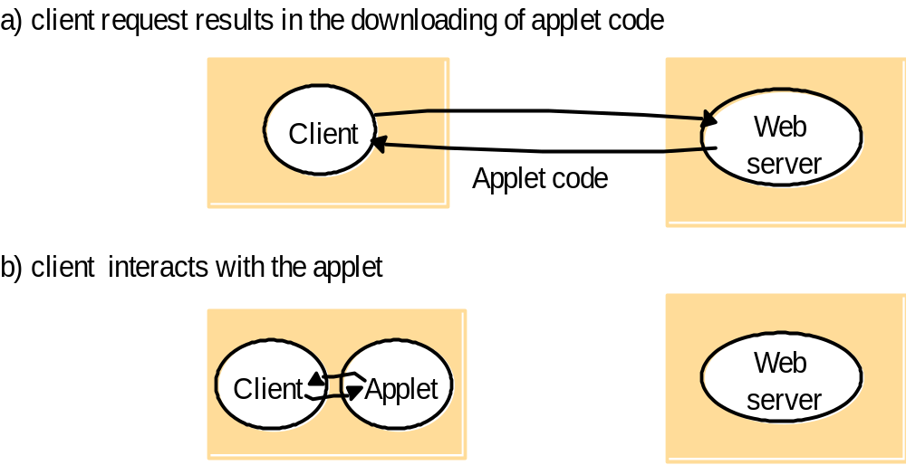
Variants of Client Sever Model
SYSTEM MODEL
Figure 8. Web applets
Distributed System (DS)
Notes:
CP8304- Ryerson University

Slide 28
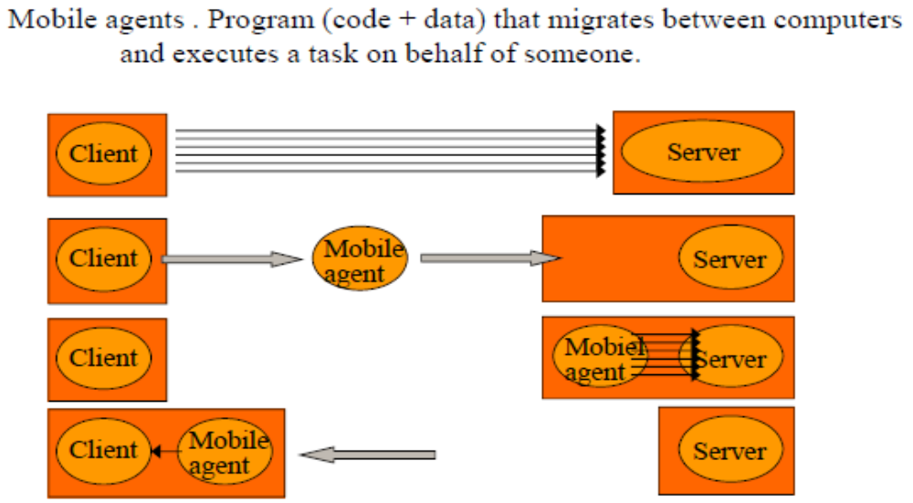
Variants of Client Sever Model
SYSTEM MODEL
Mobile agents
Distributed System (DS)
Notes:
CP8304- Ryerson University

Slide 29
Variants of Client Sever Model
SYSTEM MODEL
Mobile agents A running program (code and data) that travels from one computer to another in a network carrying out of a task, usually on behalf of some other process. Examples of the tasks that can be done by mobile agents are: To collect information. To install and maintain software maintained on the computers within an organization. To compare the prices of products from a number of vendors.
Distributed System (DS)
Notes:
CP8304- Ryerson University

Slide 30
Variants of Client Sever Model
SYSTEM MODEL
Mobile agents are a potential security threat to the resources in computers that they visit. The environment receiving a mobile agent should decide on which of the local resources to be allowed to use. Mobile agents themselves can be vulnerable They may not be able to complete their task if they are refused access to the information they need.
Distributed System (DS)
Notes:
CP8304- Ryerson University

Slide 31
Variants of Client Sever Model
SYSTEM MODEL
Mobile devices and spontaneous interoperation Mobile devices are hardware computing components that move between physical locations and thus networks, carrying software component with them. Many of these devices are capable of wireless networking ranges of hundreds of meters such as WiFi (IEEE 802.11), or about 10 meters such as Bluetooth.
Distributed System (DS)
Notes:
CP8304- Ryerson University

Slide 32
Variants of Client Sever Model
SYSTEM MODEL
Network computers It downloads its operating system and any application software needed by the user from a remote file server. Applications are run locally but the files are managed by a remote file server. Network applications such as a Web browser can also be run.
Distributed System (DS)
Notes:
CP8304- Ryerson University

Slide 33
Variants of Client Sever Model
SYSTEM MODEL
Thin clients It is a software layer that supports a window-based user interface on a computer that is local to the user while executing application programs on a remote computer. This architecture has the same low management and hardware costs as the network computer scheme. Instead of downloading the code of applications into the user’s computer, it runs them on a compute server.
Distributed System (DS)
Notes:
CP8304- Ryerson University

Slide 34
Variants of Client Sever Model
SYSTEM MODEL
Compute server is a powerful computer that has the capacity to run large numbers of application simultaneously. The compute server will be a multiprocessor or cluster computer running a multiprocessor version of an operation system such as UNIX or Windows.
Compute server
Network computer or PC
Thin
network
Application
Client
Process
Figure 9. Thin clients and compute servers
Distributed System (DS)
Notes:
CP8304- Ryerson University

Slide 35
Decentralized system architectures
SYSTEM MODEL
Referred to as peer-to-peer (P2P) systems Every node act both as a client and server (“servant”), and “pays” for the participation by offering access to some if its resources (typically processing and storage resources, but can also be logical resources (services) Advantages: no single point of failure, scalability Disadvantages: complexity of protocols Many application areas File sharing, streaming, process sharing, collaborative and social applications, web-caching etc.
Distributed System (DS)
Notes:
CP8304- Ryerson University

Slide 36
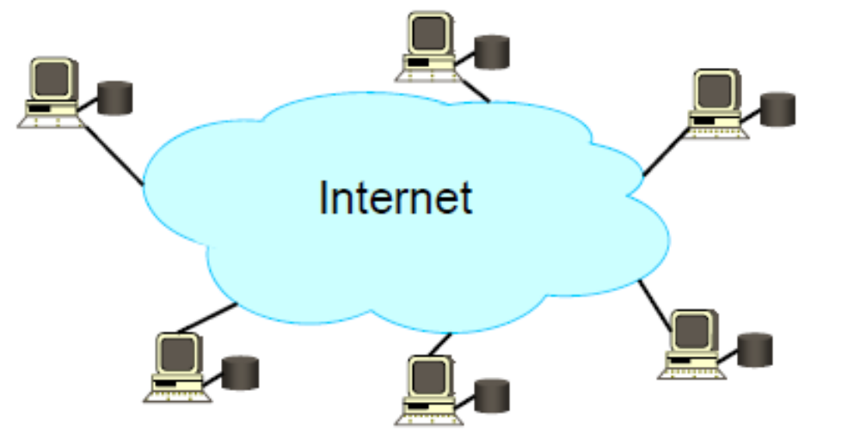
Example: P2P file sharing (1)
SYSTEM MODEL
Key idea: share the content, storage and bandwidth of individual (home) users Model Each user stores a subset of files Each user has access (can download) files from all users in the System
Distributed System (DS)
Notes:
CP8304- Ryerson University

Slide 37
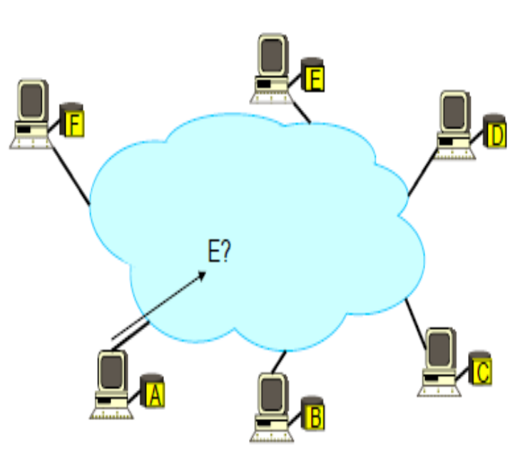
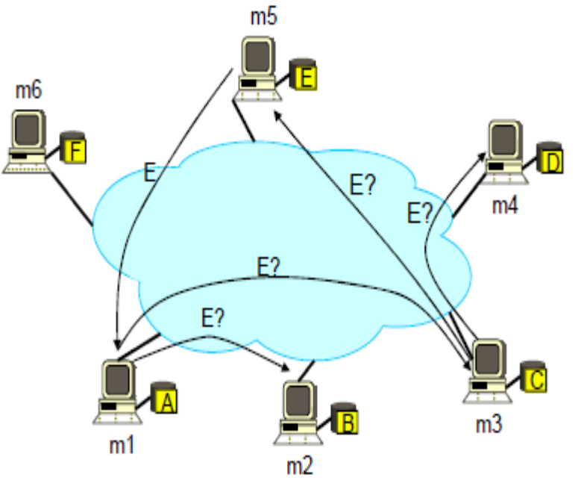
Example: P2P file sharing (1)
SYSTEM MODEL
Main challenge Find where a particular file is stored
Gnutella: Ask your neighbor
Assume: m1’s neighbors are m2 and m3; m3’s neighbors are m4 and m5;…
Distributed System (DS)
Notes:
CP8304- Ryerson University

Slide 38
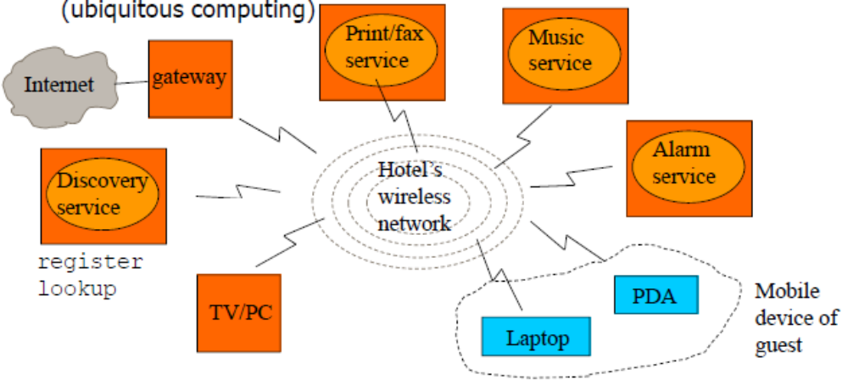
Spontaneous networks
SYSTEM MODEL
Clients carry mobile devices (laptop, PDA, ….) between different network environments (hotel network, airport network, …) and can exploit local and remote services while on the move using 3G, WiFi,...(ubiquitous computing)
Distributed System (DS)
Notes:
CP8304- Ryerson University

Slide 39
Design Requirements for distributed architectures
SYSTEM MODEL
Performance Issues Performance issues arising from the limited processing and communication capacities of computers and networks are considered under the following subheading: Responsiveness E.g. a web browser can access the cached pages faster than the non-cached pages. Throughput Load balancing E.g. using applets on clients, remove the load on the server.
Distributed System (DS)
Notes:
CP8304- Ryerson University

Slide 40
Design Requirements for distributed architectures
SYSTEM MODEL
Quality of service The ability of systems to meet deadlines. It depends on availability of the necessary computing and network resources at the appropriate time. This implies a requirement for the system to provide guaranteed computing and communication resources that are sufficient to enable applications to complete each task on time. E.g. the task of displaying a frame of video
Distributed System (DS)
Notes:
CP8304- Ryerson University

Slide 41
Design Requirements for distributed architectures
SYSTEM MODEL
The main properties of the quality of the service are: Reliability Security Performance Adaptability
Distributed System (DS)
Notes:
CP8304- Ryerson University

Slide 42
Design Requirements for distributed architectures
SYSTEM MODEL
Use of caching and replication Distributed systems overcome the performance issues by the use of data replication and caching. Dependability issues Dependability of computer systems is defined as: Correctness Security Security is locating sensitive data and other resources only in computers that can be secured effectively against attack. E.g. a hospital database Fault tolerance Dependable applications should continue to function in the presence of faults in hardware, software, and networks. Reliability is achieved by redundancy.
Distributed System (DS)
Notes:
CP8304- Ryerson University

Slide 43
Fundamental Models
SYSTEM MODEL
Introduction Interaction Model Failure Model Security Model
Distributed System (DS)
Notes:
CP8304- Ryerson University

Slide 44
Fundamental Models-Intro
SYSTEM MODEL
Fundamental Models are concerned with a more formal description of the properties that are common in all of the architectural models. All architectural models are composed of processes that communicate with each other by sending messages over a computer networks.
Distributed System (DS)
Notes:
CP8304- Ryerson University

Slide 45
Fundamental Models-Intro
SYSTEM MODEL
Aspects of distributed systems that are discussed in fundamental models are: Interaction model Computation occurs within processes. The processes interact by passing messages, resulting in: Communication (information flow) Coordination (synchronization and ordering of activities) between processes Interaction model reflects the facts that communication takes place with delays. Failure model Failure model defines and classifies the faults.
Distributed System (DS)
Notes:
CP8304- Ryerson University

Slide 46
Fundamental Models-Intro
SYSTEM MODEL
Security model Security model defines and classifies the forms of attacks. It provides a basis for analysis of threats to a system It is used to design of systems that are able to resist threats.
Distributed System (DS)
Notes:
CP8304- Ryerson University

Slide 47
Interaction Model
SYSTEM MODEL
Distributed systems are composed of many processes, interacting in the following ways: Multiple server processes may cooperate with one another to provide a service E.g. Domain Name Service A set of peer processes may cooperate with one another to achieve a common goal E.g. voice conferencing
Distributed System (DS)
Notes:
CP8304- Ryerson University

Slide 48
Interaction Model
SYSTEM MODEL
Significant factors affecting interacting processes in a distributed system are: Communication performance is often a limiting characteristic. It is impossible to maintain a single global notion of time.
Distributed System (DS)
Notes:
CP8304- Ryerson University

Slide 49
Interaction Model-Communication Channels
SYSTEM MODEL
Performance of communication channels The communication channels in our model are realized in a variety of ways in distributed systems, for example By an implementation of streams By simple message passing over a computer network Communication over a computer network has the performance characteristics such as: Latency The delay between the start of a message’s transmission from one process to the beginning of its receipt by another.
Distributed System (DS)
Notes:
CP8304- Ryerson University

Slide 50
Interaction Model-Communication Channels
SYSTEM MODEL
Bandwidth The maximum amount of information that can be transmitted over a computer network in a given time. Communication channels using the same network, have to share the available bandwidth. Jitter The variation in the time taken to deliver a series of messages. It is relevant to multimedia data. For example, if consecutive samples of audio data are played with differing time intervals then the sound will be badly distorted.
Distributed System (DS)
Notes:
CP8304- Ryerson University

Slide 51
Interaction Model-Computer Clock
SYSTEM MODEL
Computer clocks and timing events Each computer in a distributed system has its own internal clock, which can be used by local processes to obtain the value of the current time. Two processes running on different computers can associate timestamp with their events. Even if two processes read their clock at the same time, their local clocks may supply different time.
Distributed System (DS)
Notes:
CP8304- Ryerson University

Slide 52
Interaction Model-Computer Clock
SYSTEM MODEL
This is because computer clock drift from perfect time and their drift rates differ from one another. Clock drift rate refers to the relative amount that a computer clock differs from a perfect reference clock. Even if the clocks on all the computers in a distributed system are set to the same time initially, their clocks would eventually vary quite significantly unless corrections are applied. There are several techniques to correct time on computer clocks. For example, computers may use radio signal receivers to get readings from GPS (Global Positioning System) with an accuracy about 1 microsecond.
Distributed System (DS)
Notes:
CP8304- Ryerson University

Slide 53
Interaction Model-Variations
SYSTEM MODEL
Two variants of the interaction model In a distributed system it is hard to set time limits on the time taken for process execution, message delivery or clock drift. Two models of time assumption in distributed systems are: Synchronous distributed systems It has a strong assumption of time The time to execute each step of a process has known lower and upper bounds. Each message transmitted over a channel is received within a known bounded time. Each process has a local clock whose drift rate from real time has a known bound.
Distributed System (DS)
Notes:
CP8304- Ryerson University

Slide 54
Interaction Model
SYSTEM MODEL
Asynchronous distributed system It has no assumption about time. There is no bound on process execution speeds. Each step may take an arbitrary long time. There is no bound on message transmission delays. A message may be received after an arbitrary long time. There is no bound on clock drift rates. The drift rate of a clock is arbitrary.
Distributed System (DS)
Notes:
CP8304- Ryerson University

Slide 55
Interaction Model
SYSTEM MODEL
Event ordering In many cases, we are interested in knowing whether an event (sending or receiving a message) at one process occurred before, after, or concurrently with another event at another process. The execution of a system can be described in terms of events and their ordering despite the lack of accurate clocks.
Distributed System (DS)
Notes:
CP8304- Ryerson University

Slide 56
Interaction Model
SYSTEM MODEL
For example, consider a mailing list with users X, Y, Z, and A. User X sends a message with the subject Meeting. Users Y and Z reply by sending a message with the subject RE: Meeting. In real time, X’s message was sent first, Y reads it and replies; Z reads both X’s message and Y’s reply and then sends another reply, which references both X’s and Y’s messages. But due to the independent delays in message delivery, the messages may be delivered in the order is shown in figure 10. It shows user A might see the two messages in the wrong order. (Figure 10)
Distributed System (DS)
Notes:
CP8304- Ryerson University

Slide 57
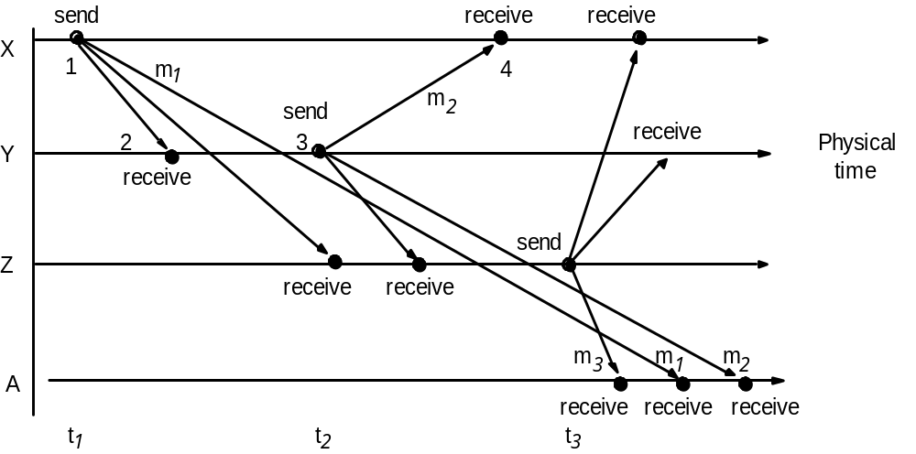
Interaction Model
SYSTEM MODEL
Figure 10. Real-time ordering of events.
Distributed System (DS)
Notes:
CP8304- Ryerson University

Slide 58
Interaction Model
SYSTEM MODEL
Some users may view two messages in the wrong order, for example, user A might see Item is a sequence number that shows the order of receiving emails.
Item | From | Subject
23 | Z | Re: Meeting
24 | X | Meeting
26 | Y | Re: Meeting
Distributed System (DS)
Notes:
CP8304- Ryerson University

Slide 59
Failure Model
SYSTEM MODEL
In a distributed system both processes and communication channels may fail – That is, they may depart from what is considered to be correct or desirable behavior. Types of failures: Omission Failures Arbitrary Failures Timing Failures
Distributed System (DS)
Notes:
CP8304- Ryerson University

Slide 60
Failure Model
SYSTEM MODEL
Omission failure Omission failures refer to cases when a process or communication channel fails to perform actions that it is supposed to do. The chief omission failure of a process is to crash. In case of the crash, the process has halted and will not execute any further steps of its program. Another type of omission failure is related to the communication which is called communication omission failure shown in Figure 11.
Distributed System (DS)
Notes:
CP8304- Ryerson University

Slide 61
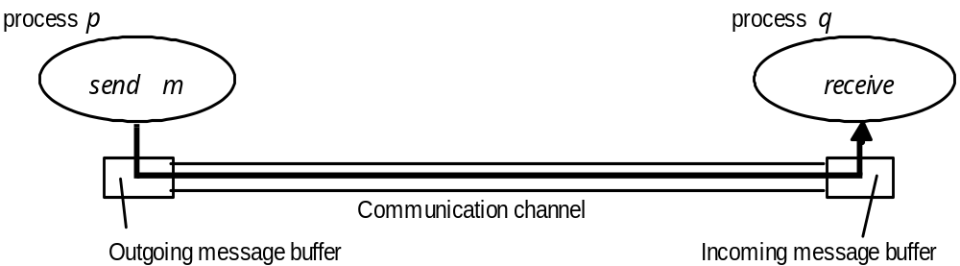
Failure Model
SYSTEM MODEL
Figure 11. Processes and channels.
The communication channel produces an omission failure if it does not transport a message from “p”s outgoing message buffer to “q”’s incoming message buffer. This is known as “dropping messages” and is generally caused by lack of buffer space at the receiver or at a gateway or by a network transmission error, detected by a checksum carried with the message data.
Distributed System (DS)
Notes:
CP8304- Ryerson University

Slide 62
Failure Model
SYSTEM MODEL
Arbitrary failure Arbitrary failure is used to describe the worst possible failure semantics, in which any type of error may occur. E.g. a process may set a wrong values in its data items, or it may return a wrong value in response to an invocation. Communication channel can suffer from arbitrary failures. E.g. message contents may be corrupted or non-existent messages may be delivered or real messages may be delivered more than once.
Distributed System (DS)
Notes:
CP8304- Ryerson University

Slide 63
Failure Model
SYSTEM MODEL
The omission failures are classified together with arbitrary failures shown below
Class of failure
Affects
Description
Fail-stop
Process
Process halts and remains halted. Other processes may
detect this state.
Crash
Process
Process halts and remains halted. Other processes may
not be able to detect this state.
Omission
Channel
A message inserted in an outgoing message buffer never
arrives at the other end’s incoming message buffer.
Send-omission
Process
A process completes a
send,
but the message is not put
in its outgoing message buffer.
Receive-omission
Process
A message is put in a process’s incoming message
buffer, but that process does not receive it.
Arbitrary
Process or
Process/channel exhibits arbitrary behaviour: it may
(complex)
channel
send/transmit arbitrary messages at arbitrary times,
commit omissions; a process may stop or take an
Distributed System (DS)
incorrect step.
Notes:
CP8304- Ryerson University

Slide 64
Failure Model
SYSTEM MODEL
Timing failure Timing failures are applicable in synchronized distributed systems where time limits are set on process execution time, message delivery time and clock drift rate.
Class of Failure
Affects
Description
Clock
Process
Process’s local clock exceeds the bounds on its
rate of drift from real time.
Performance
Process
Process exceeds the bounds on the interval
between two steps.
Performance
Channel
A message’s transmission takes longer than the
stated bound.
Distributed System (DS)
Notes:
CP8304- Ryerson University

Slide 65
Failure Model
SYSTEM MODEL
Masking failure It is possible to construct reliable services from components that exhibit failure. E.g. multiple servers that hold replicas of data can continue to provide a service when one of them crashes. A service masks a failure, either by hiding it altogether or by converting it into a more acceptable type of failure. E.g. checksums are used to mask corrupted messages- effectively converting an arbitrary failure into an omission failure.
Distributed System (DS)
Notes:
CP8304- Ryerson University

Slide 66
Security Model
SYSTEM MODEL
The security of a distributed system can be achieved by securing the processes and the channels used in their interactions. Also, by protecting the objects that they encapsulate against unauthorized access.
Distributed System (DS)
Notes:
CP8304- Ryerson University

Slide 67
Security Model
SYSTEM MODEL
Protecting Objects Access rights Access rights specify who is allowed to perform the operations on an object. Who is allowed to read or write its state. Principal Principal is the authority associated with each invocation and each result. A principal may be a user or a process. The invocation comes from a user and the result from a server.
Distributed System (DS)
Notes:
CP8304- Ryerson University

Slide 68
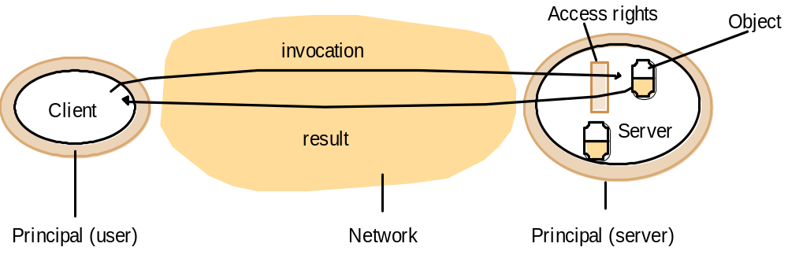
Security Model
SYSTEM MODEL
The sever is responsible for Verifying the identity of the principal (user) behind each invocation. Checking that they have sufficient access rights to perform the requested operation on the particular object invoked. Rejecting those that do not.
Distributed System (DS)
Notes:
CP8304- Ryerson University

Slide 69
Security Model
SYSTEM MODEL
The enemy To model security threats, we assume an enemy that is capable of sending any message to any process and reading or copying any message between a pair of processes.
Copy of
m
The enemy
m’
p
m
Process
q
Process
Communication channel
Distributed System (DS)
Notes:
CP8304- Ryerson University

Slide 70
Security Model
SYSTEM MODEL
Threats from a potential enemy are classified as: Threats to processes Threats to communication channels Denial of service
Distributed System (DS)
Notes:
CP8304- Ryerson University

Slide 71
Security Model
SYSTEM MODEL
Defeating security threats Secure systems are based on the following main techniques: Cryptography and shared secrets Cryptography is the science of keeping message secure. Encryption is the process of scrambling a message in such a way as to hide its contents. Authentication The use of shared secrets and encryption provides the basis for the authentication of messages.
Distributed System (DS)
Notes:
CP8304- Ryerson University

Slide 72
Security Model
SYSTEM MODEL
Secure channels Encryption and authentication are used to build secure channels as a service layer on top of the existing communication services. A secure channel is a communication channel connecting a pair of processes, each of which acts on behalf of a principal. VPN (Virtual Private Network) and secure socket layer (SSL) protocols are instances of secure channel.
Principal
A
Principal
B
Process
p
Secure channel
Process
q
Distributed System (DS)
Notes:
CP8304- Ryerson University

Slide 73
Security Model
SYSTEM MODEL
Other possible threats from an enemy Denial of service This is a form of attack in which the enemy interferes with the activities of authorized users by making excessive and pointless invocations on services of message transmissions in a network. It results in overloading of physical resources (network bandwidth, server processing capacity).
Distributed System (DS)
Notes:
CP8304- Ryerson University

Slide 74
Security Model
SYSTEM MODEL
Mobile code Mobile code is security problem for any process that receives and executes program code from elsewhere, such as the email attachment. Such attachment may include a code that accesses or modifies resources that are available to the host process but not to the originator of the code.
Distributed System (DS)
Notes:
CP8304- Ryerson University

